Slide 1
Quia
How to Create Your Own Account

Slide 2
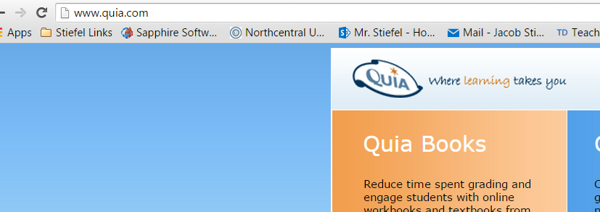
Go to this website

Slide 3
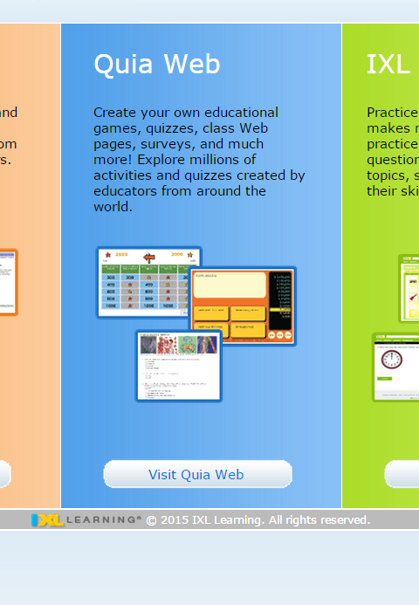
Click on Quia Web

Slide 4
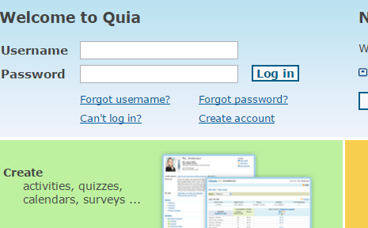
Create an Account

Slide 5
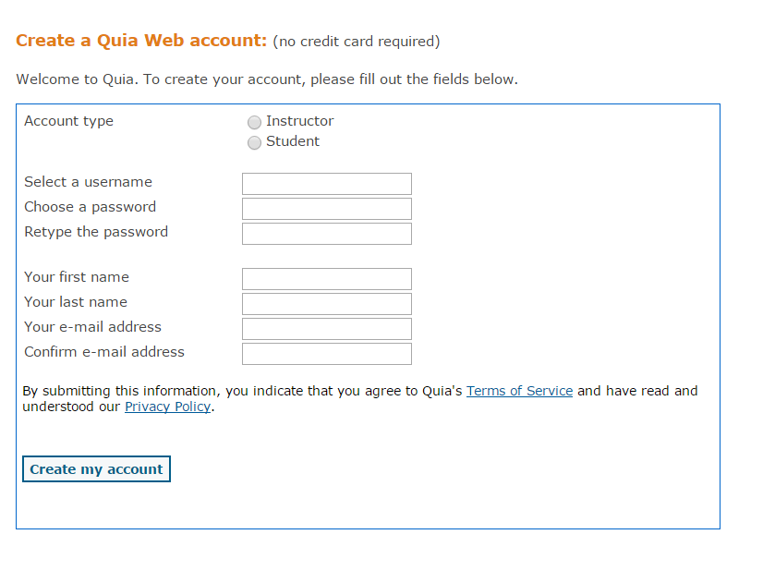
Use your school email login and ID
Use your real name
Use your school email: 2#lastfirst@seal-pa.org

Slide 6
You will receive a class code from your teacher.

Slide 7
You should now see Stiefel #. Click on it.

Slide 8
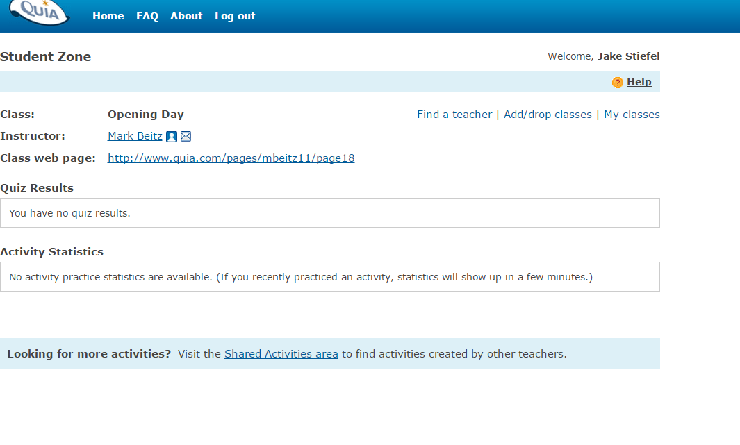
Always use the Class Web Page link to find your activities.
This is where you will see your activity/quiz results after you finish.

Slide 9
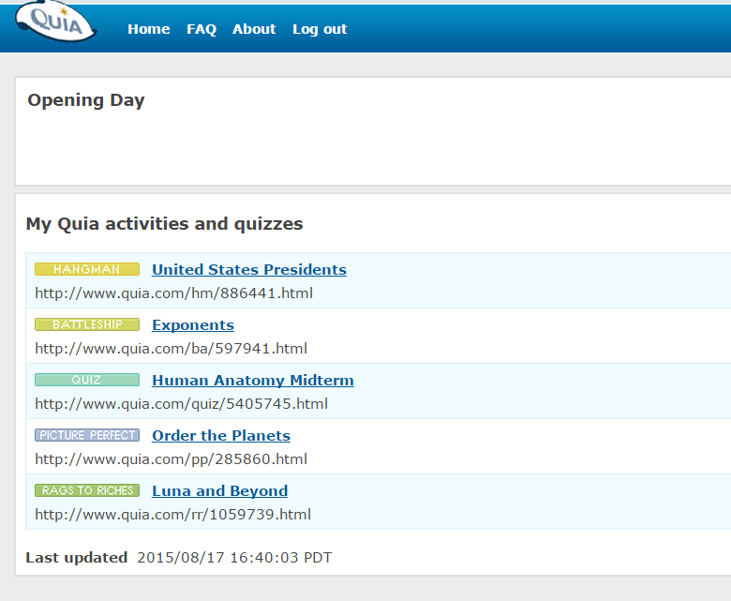
Here is where you will see your activities for the class.

